Slide 1
HTML – An Overview
Hyper-text Markup Language – The Skeleton of the Web

Slide 2

What is HTML?
HTML stands for Hyper-text Markup Language.
It is the standard markup language used to create web pages.
Web browsers use HTML to interpret and compose text, images, and other material into visual or audible web pages.

Slide 3
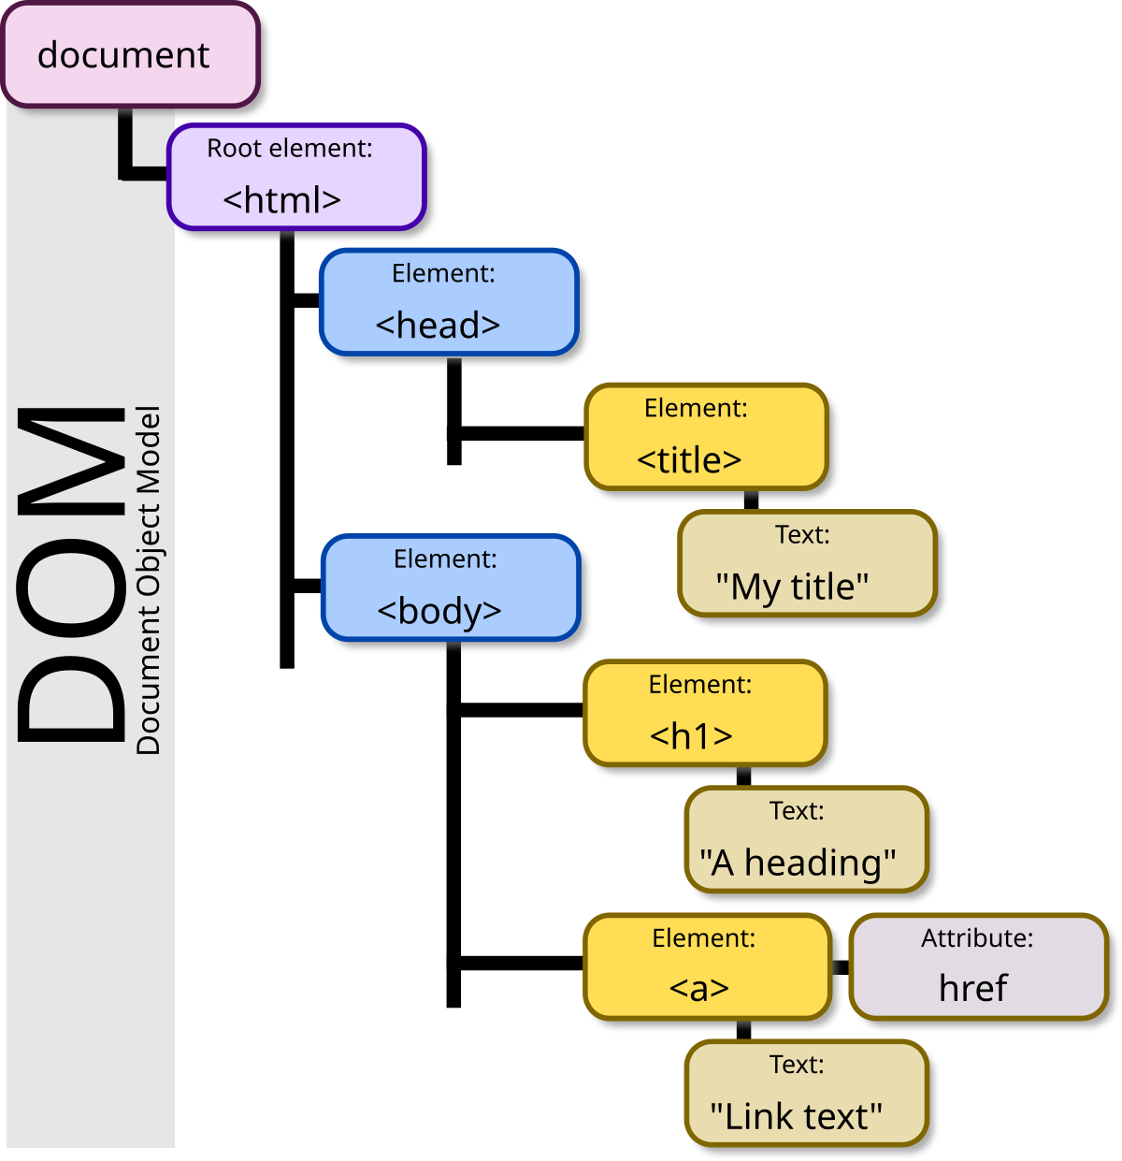
Structure of an HTML Document
<!DOCTYPE html>
Defines the document type
<html>
Root element of the document
<head>
Contains metadata, such as title, links to stylesheets, etc.
<body>
Contains the content visible on the web page

Slide 4
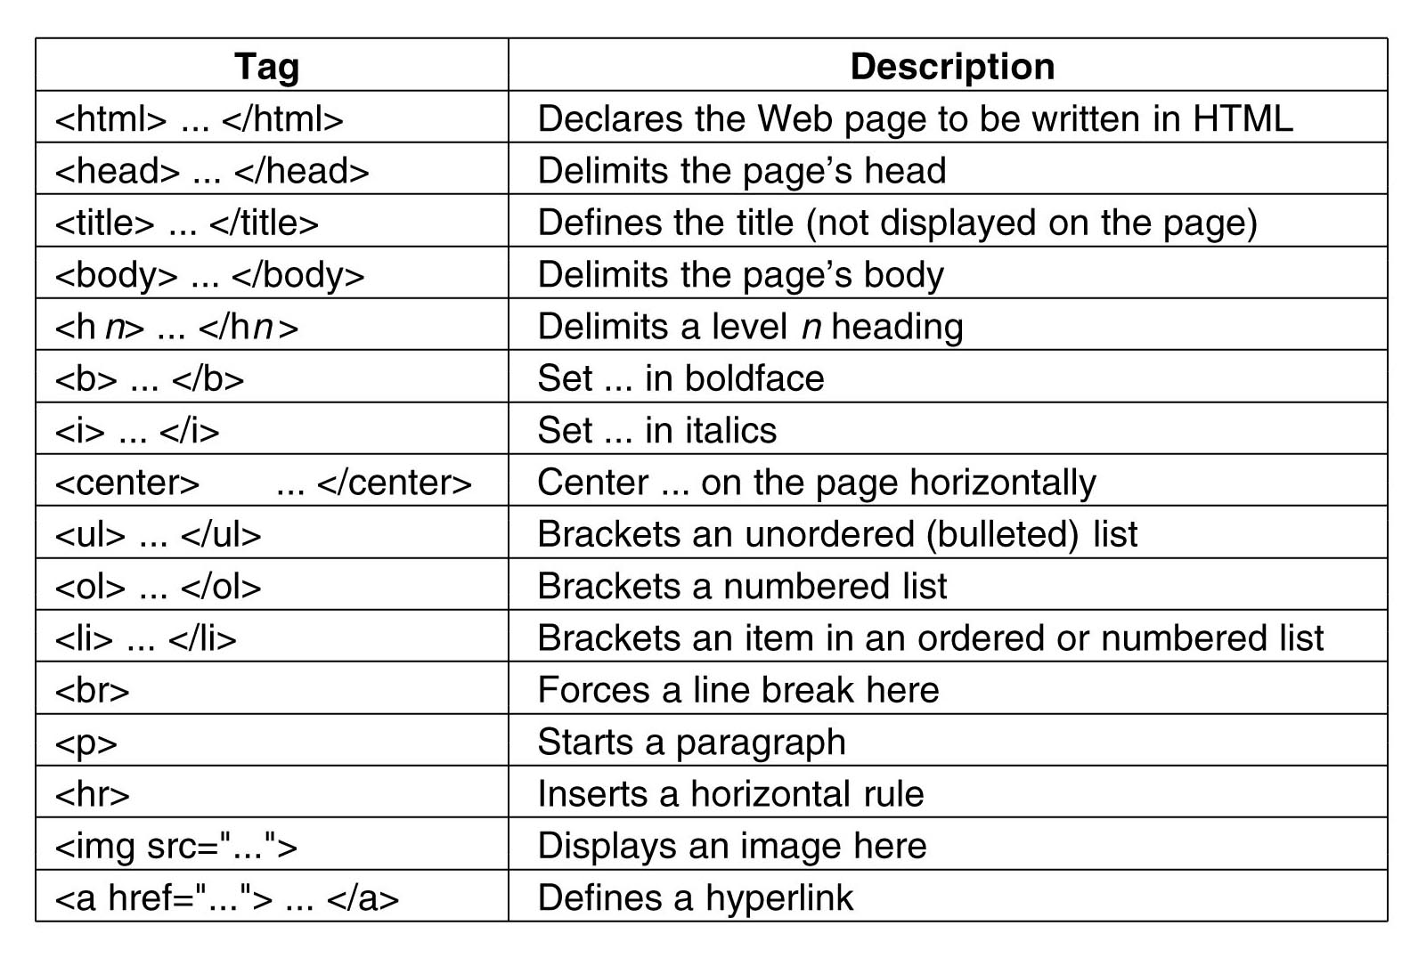
Common HTML Tags
<h1> to <h6>
Header tags
<p>
Paragraph
<a>
Anchor (links)
<img>
Images
<div>
Division or block of content
<span>
Inline section of content

Slide 5
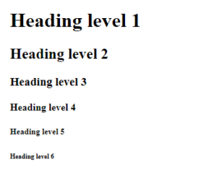
Heading Tags
Used to define headings.
<h1> is the most important, <h6> is the least important.
Example:
<h1>This is an H1 heading</h1>
<h2>This is an H2 heading</h2>
<h3>This is an H3 heading</h3>
<h4>This is an H4 heading</h4>
<h5>This is an H5 heading</h5>
<h6>This is an H6 heading</h6>

Slide 6

Paragraph and Line Break Tags
<p>
Defines a paragraph.
<br>
Inserts a line break.
Example:
<p>This is a paragraph.<br>This text will start on a new line. </p>

Slide 7

Anchor Tags
<a>
Used to create hyperlinks.
Example:
<a href="https://example.com">Click here</a>
Note:
We can also create links within the same page using id.

Slide 8

Image Tags
<img>
Used to insert images.
Example:
<img src="image.jpg" alt="Image description">
Attributes:
src, alt, width, height.

Slide 9
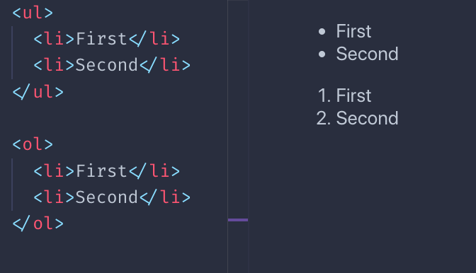
List Tags
Unordered List (<ul>):
Bulleted list.
Ordered List (<ol>):
Numbered list.
List items are defined with the <li> tag.
Example:
<ul>
<li>Item 1</li>
<li>Item 2</li>
</ul>

Slide 10
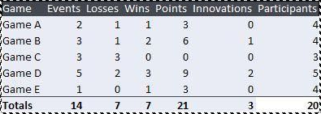
Table Tags
<table>:
Defines a table.
<tr>:
Table row.
<td>:
Table data/cell.
<th>:
Table header.
Example:
<table>
<tr>
<th>Header 1</th>
<th>Header 2</th>
</tr>
<tr>
<td>Data 1</td>
<td>Data 2</td>
</tr>
</table>

Slide 11
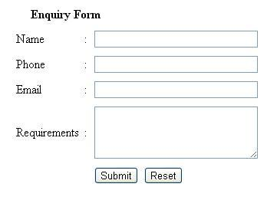
Forms in HTML
<form>
Used to collect user input.
Elements:
<input>, <textarea>, <select>, <button>.
Example:
<form action="/submit">
<input type="text" name="name">
<button type="submit">Submit</button>
</form>

Slide 12
Container Tags v/s Standalone Tags
Container Tags
Standalone Tags
Definition: These tags wrap content and always come with an opening and a closing tag.
Example:
<div></div>
<p></p>
<section></section>.
Usage: Used to group content and provide structure.
Definition: These tags do not have closing tags and are self-contained.
Example:
<img>
<br>
<input>.
Usage: Used for elements that do not need enclosing content.

Slide 13
Semantic Tags v/s Non-Semantic Tags
Semantic Tags
Non-Semantic Tags
Definition: Tags that clearly describe their meaning in a human- and machine-readable way.
Purpose: Makes the code more readable, accessible, and SEO-friendly.
Examples:
<article> - Represents an article or a self-contained piece of content.
<section> - Defines sections in a document.
<header>, <footer>, <nav> - Structural tags for page layout.
Definition: Tags that do not provide clear meaning about the content they contain.
Purpose: Used for general styling but do not indicate content purpose or structure.
Examples:
<div> - Used to group content without meaning.
<span> - Used for inline elements without meaning.

Slide 14
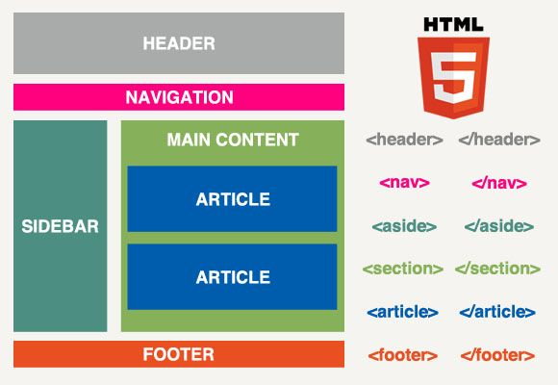
Conclusion
HTML is the foundation of web development.
Understanding basic tags helps in creating well-structured web pages.

Slide 15
Thank You! Under the Guidance of Indrakka Mam Edubridge * Capgemini - Shridhar Pandey

